Slide 1
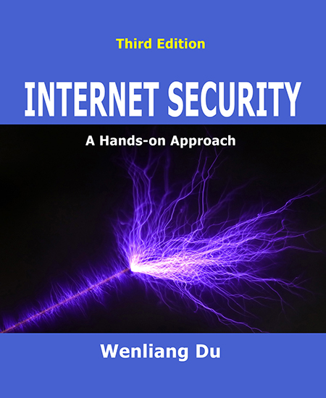
NT101-Network Security
Week 10-11: Transport Layer and Attacks
Ngoc-Tu Nguyen, PhD
tunn@uit.edu.vn

Slide 2
Outline
Transport Layer (review)
UDP Protocol and attacks
UDP Ping pong attacks
UDP Flooding – DoS attacks
TCP Protocol and attacks
TCP SYN Flooding
TCP Reset Attack
TCP Session Hijacking
Reverse Shell
The Mitnick Attack
Countermeasures

Slide 3



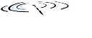


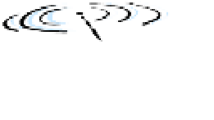



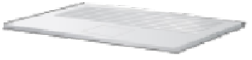
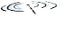


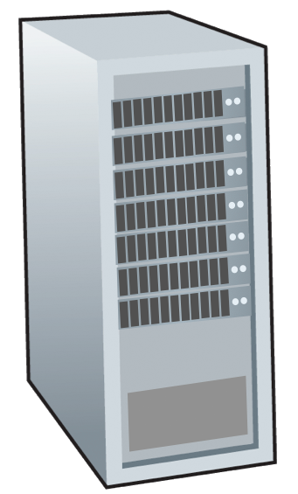














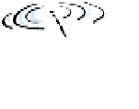


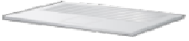
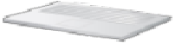
Transport protocols (review)
provide logical communication between application processes running on different hosts
transport protocols actions in end systems:
sender: breaks application messages into segments, passes to network layer
receiver: reassembles segments into messages, passes to application layer
transport protocols available to Internet applications
TCP, UDP, QUIC (TCP/2)
application
transport
network
data link
physical
mobile network
na P
local or regional ISP
home network _{co}
pro
netwo _{er}
enterprise
network
logical end-end transport
application
transport
network
data link
physical
https://datatracker.ietf.org/doc/html/rfc9000
Notes:
QUIC =Quick UDP Internet Connections

Slide 4
Transport Layer Actions
Sender:
application
application
is passed an application-layer message
app. msg
determines segment header fields values
T_{h}
transport
app. msg
transport
T_{h}
creates segment
network (IP)
network (IP)
passes segment to IP
link
link
physical
physical

Slide 5



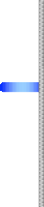

Transport Layer Actions
Receiver:
receives segment from IP
checks header values
extracts application-layer message
demultiplexes message up to application via socket
application
transport
network (IP) link
physical
application
transport
network (IP) link
physical
app. msg
T_{h}
app. msg

Slide 6
Port numbers
Overview
Port number: 16-bit unsigned numbers
Well-known ports: 0 – 1023
Examples: ftp (20, 21), ssh (22), telnet (23), smtp (25), DNS (53), http (80), https (443)
Super-user privilege needed: Why?
Less well-known ports: 1024 - 49151
Examples: openVPN (1194), Microsoft SQL server (1433), Docker (2375-2377)
Private ports: 49152 - 65535 (2^16-1)
Source ports

Slide 7




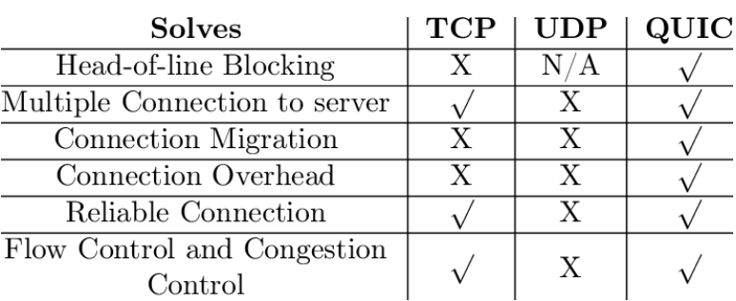
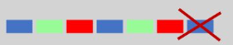
Transport layer Protocols
Overview
 | TCP | UDP
Connection | Connection-oriented Connection-less
Packet Boundary | Stream-based Maintain boundary
Reliability | ✅ ❌
Ordering | ✅ ❌
Speed | 🐢 slower 🐇 faster
Broadcast | ❌ ✅
preserve application message
(during connection setup)

Slide 8
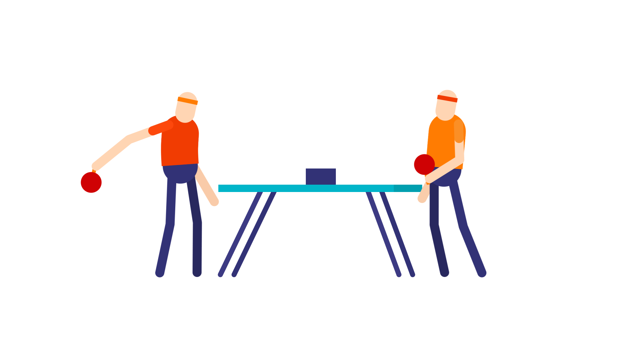
UDP Protocol and Attacks
Transport Layer (review)
UDP Protocol and attacks
UDP Ping pong attacks
UDP Flooding – DoS attacks
TCP Protocol and attacks
TCP SYN Flooding
TCP Reset Attack
TCP Session Hijacking
Reverse Shell
The Mitnick Attack
Countermeasures

Slide 9
UDP segment header
UDP header
32 bits
source port # dest port # length checksum
application data (payload)
length, in bytes of UDP segment, including header
data to/from application layer
UDP segment format

Slide 10
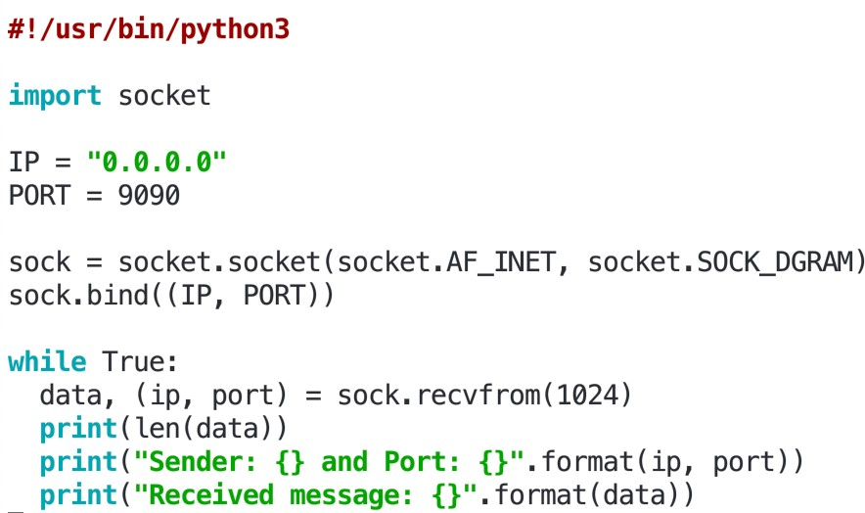
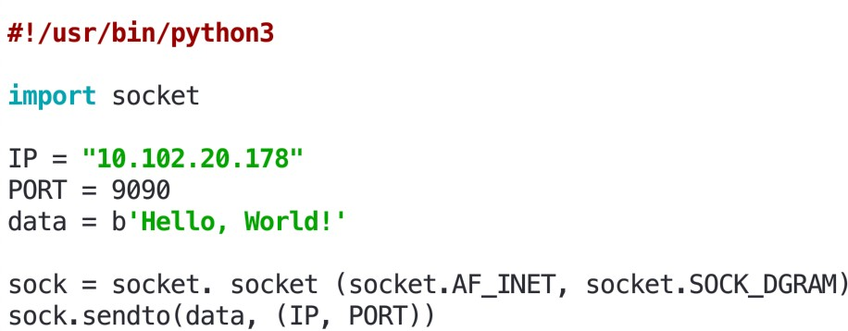
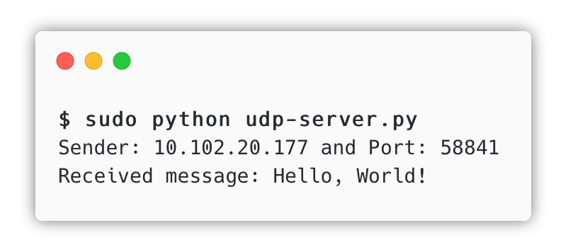
Sending/Receiving UDP packets
Python + Scapy
UDP Server example
UDP Client example

Slide 11
UDP Applications
UDP Overview
DNS Protocol
Video/Audio Streaming, Skype, Zoom
Note: Netflix and YouTube use UDP TCP, why?
Real-Time Applications
VPN Tunnel (OpenVPN)
Question
UDP does not preserve order and does not handle packet loss. If an application does care about packet loss and order, can it still use UDP?

Slide 12
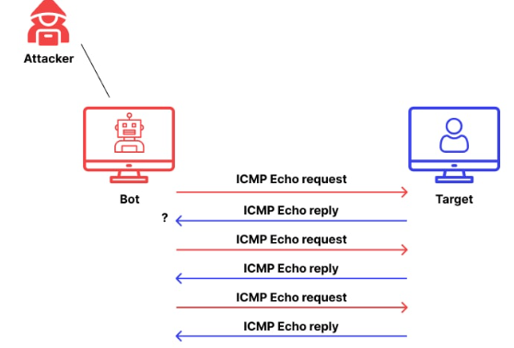
ICMP flood attack -DDoS (review)
need to reply!

Slide 13
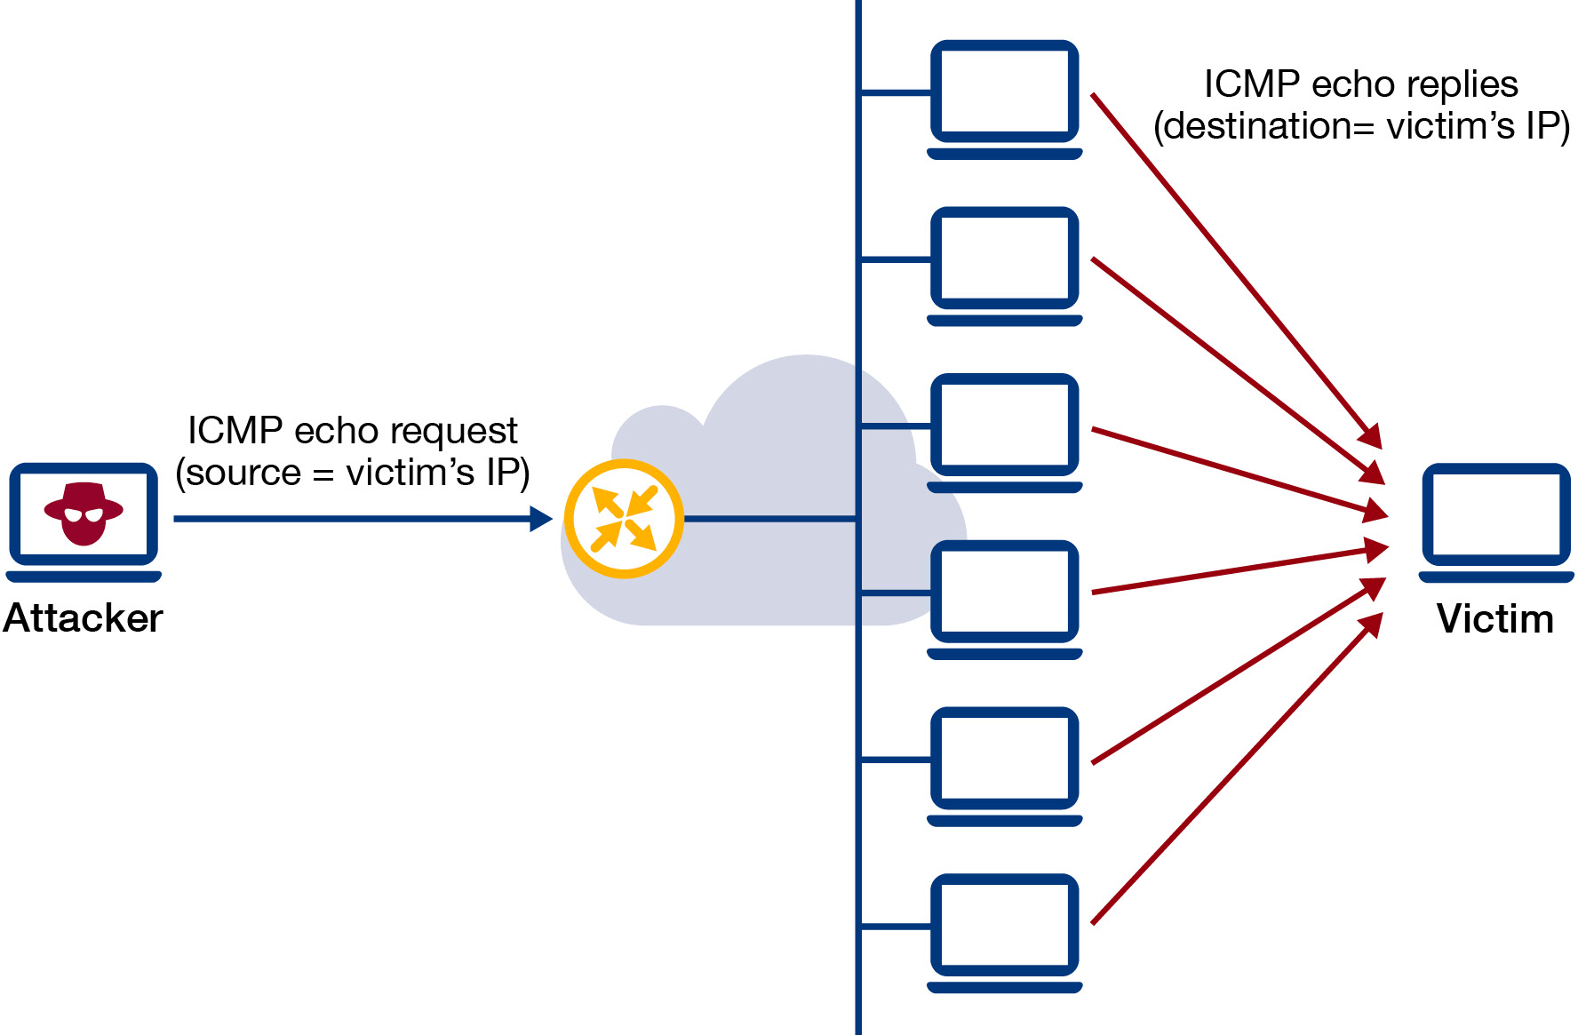
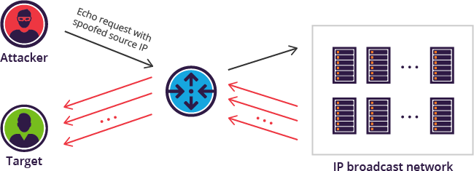

Smurf Attack (Review)
Attack ideas
Spoofing source IP
https://www.imperva.com/learn/ddos/smurf-attack-ddos/

Slide 14

UDP Ping-Pong Attacks
UDP Attacks
Some service or application issues a UDP reply no matter what is the input packet:
Daytime protocol (port 13)
Time Protocol (port 37)
Echo Protocol (port 7)
Character Generator Protocol - chargen (port 19)
➔ This causes a Ping-Pong effect between the source and the destination ➔ DDoS attack (Smurf Attack ).

Slide 15
Ping-Pong attack
Botnet?
need to reply!
13, 19, 37 …
UDP (src_port, dst_port = 7)
Reply …
UDP (src_port, dst_port = 7)
Reply …

Slide 16
UDP flood attack Attack ideas
Reply …
13, 19, 37 …
Spoofing source IP
UDP (src_port, dst_port = 7)
https://www.imperva.com/learn/ddos/smurf-attack-ddos/
Reply with large package?

Slide 17
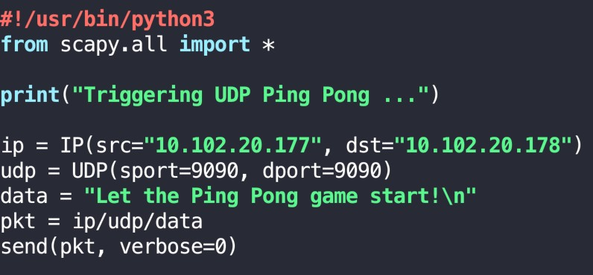
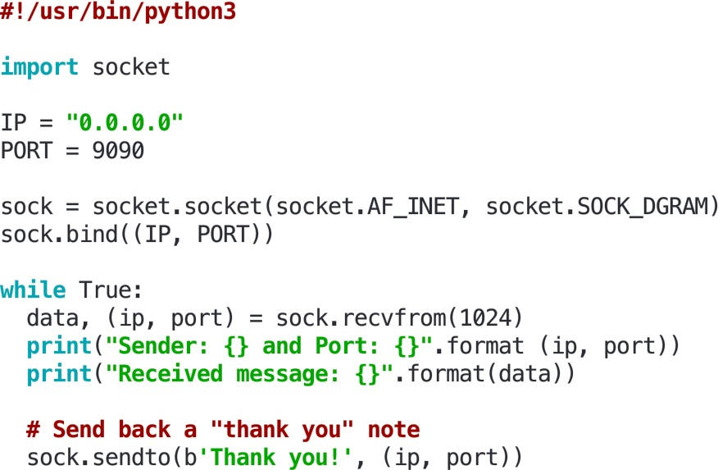
Let's Bring the Ping-Pong Game Back!
UDP Attacks
Server code
Attack code
Triggering UDP Ping Pong (spoofing)

Slide 18
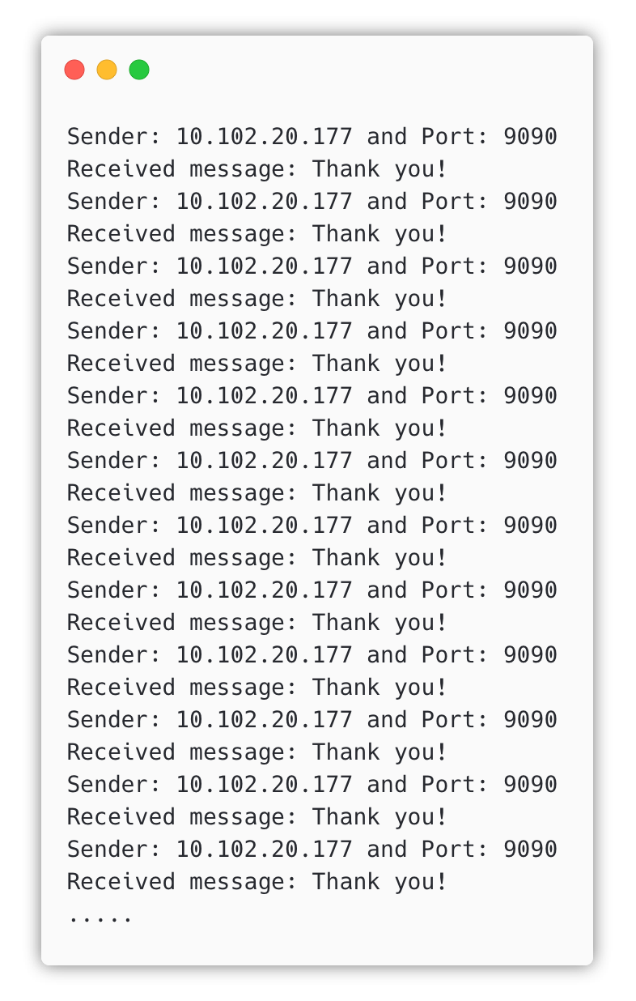
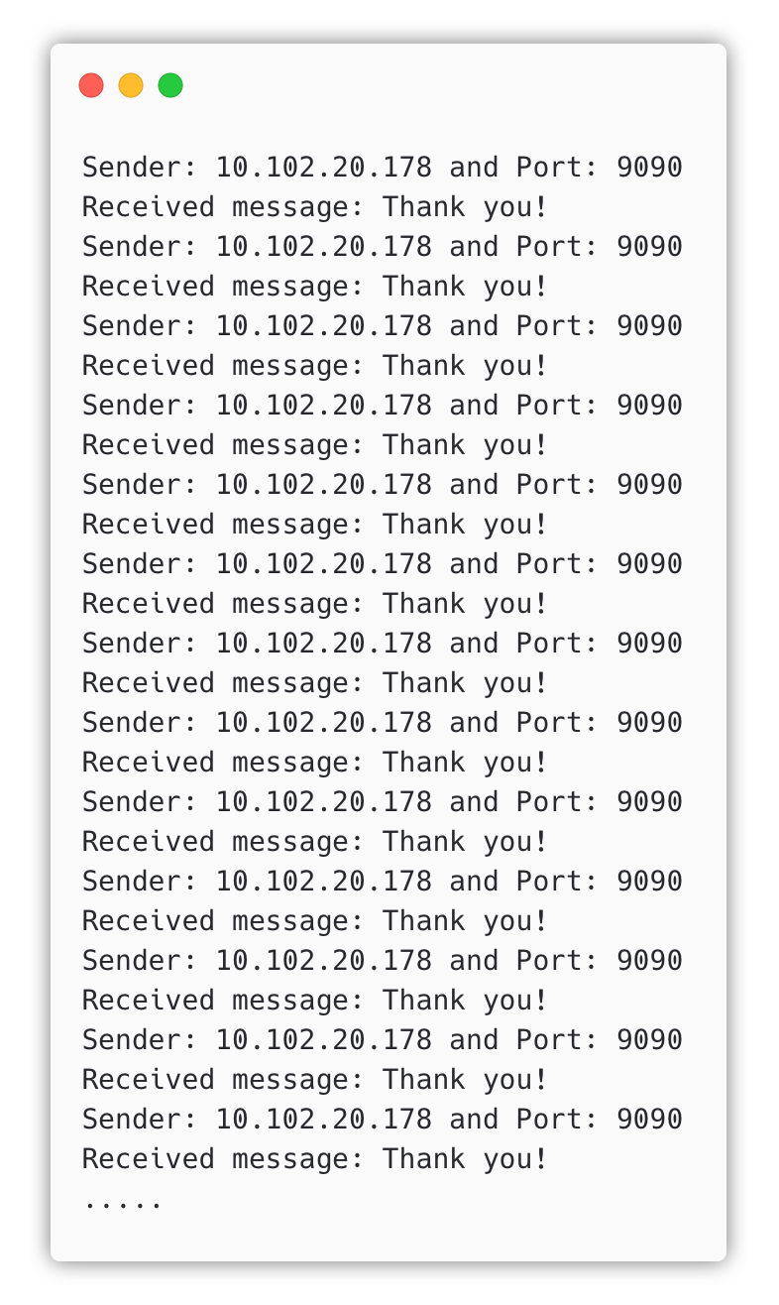

Ping-pong demo
UDP Attacks

Slide 19

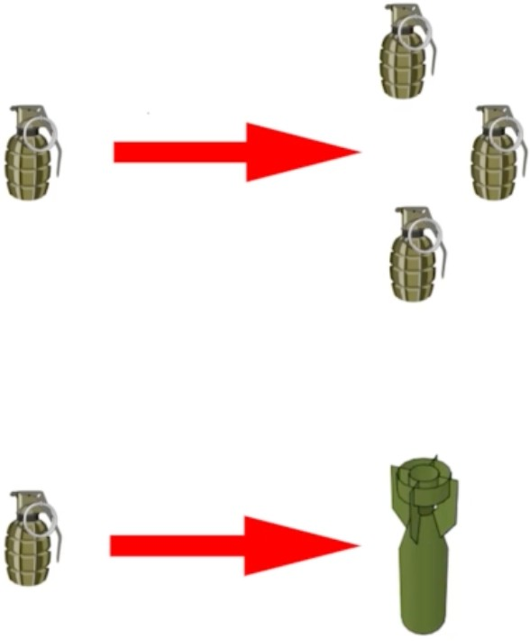
DoS Attack strategies
Recall
ICMP Smurf Attack
UDP DoS Attack
hoant@uit.edu.vn

Slide 20
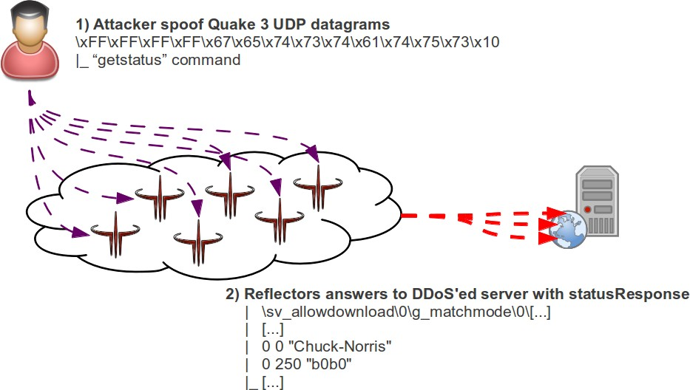
UDP Amplification Attack
UDP Attack
Idea: Applications that reply with large packets to small requests, e.g., games
BattleField 1942
Quake 1,2,3 (CAN-1999-1066)
Unreal Tournament
Hosts can be attacked by using these applications as amplifiers, with forged source IP packets
The ratio between the response and the original request pack is called amplification ratio.
https://www.christian-rossow.de/articles/Amplification_DDoS.php
20

Slide 21
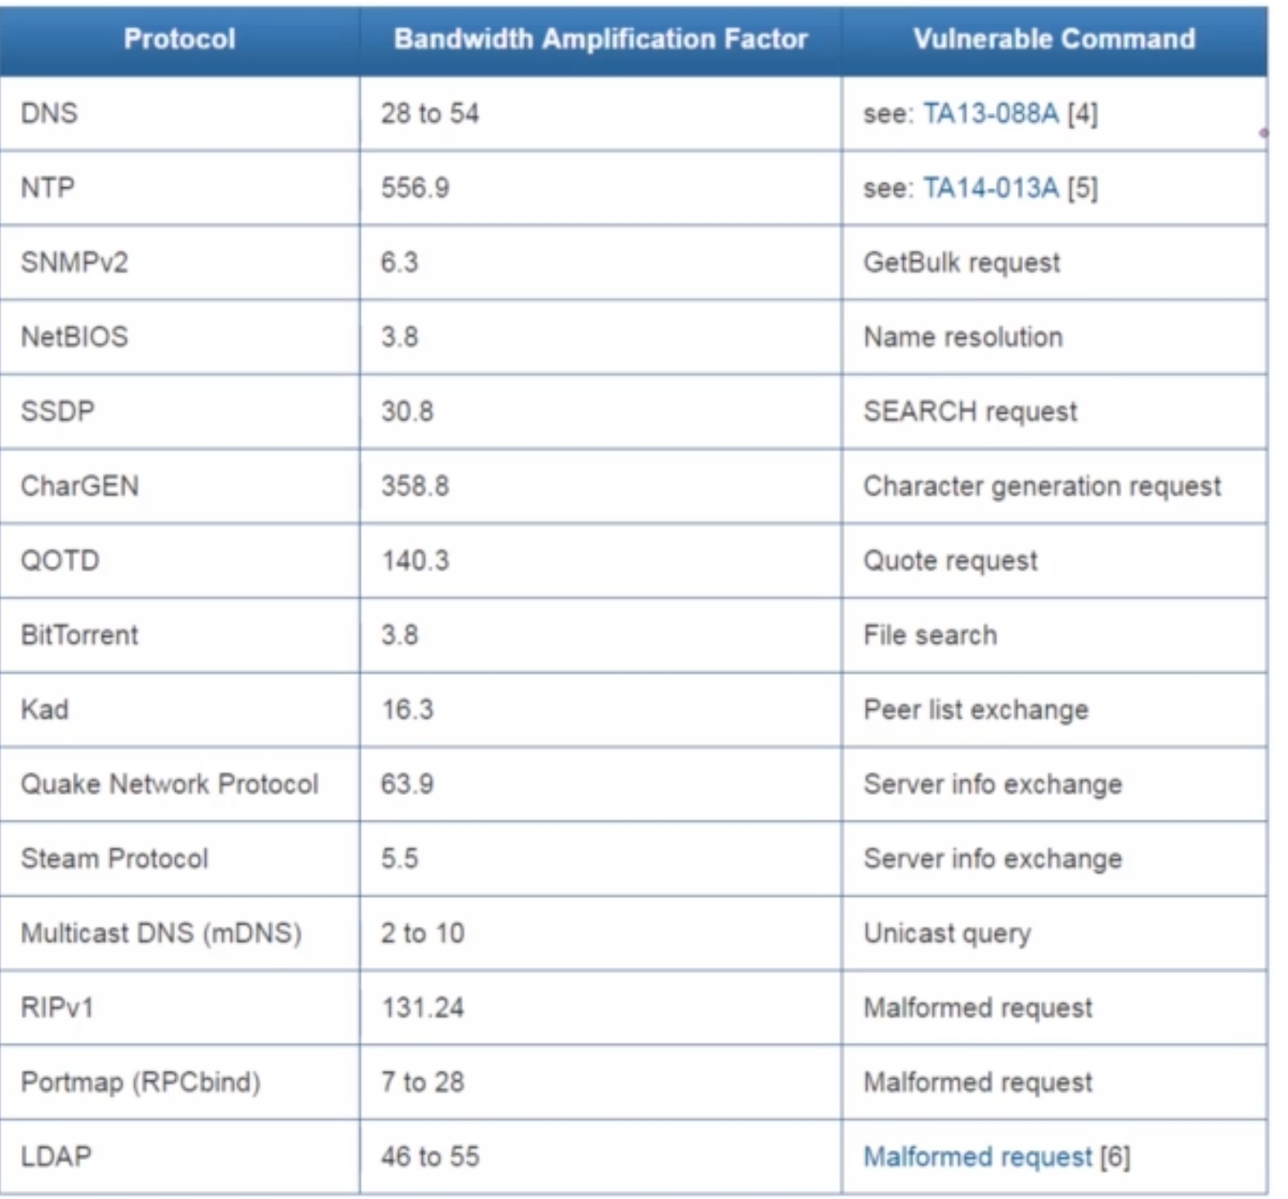
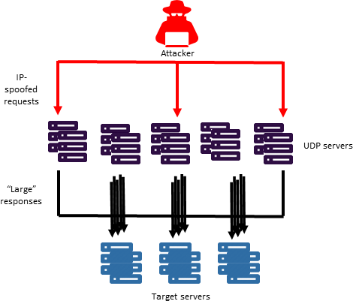
Bandwidth Amplification Factor
UDP Attack
UDP Attacks - Bottom line:
The more complicated a protocol is, the more
sophisticated attack that you can create.
https://www.christian-rossow.de/articles/Amplification_DDoS.php
21

Slide 22
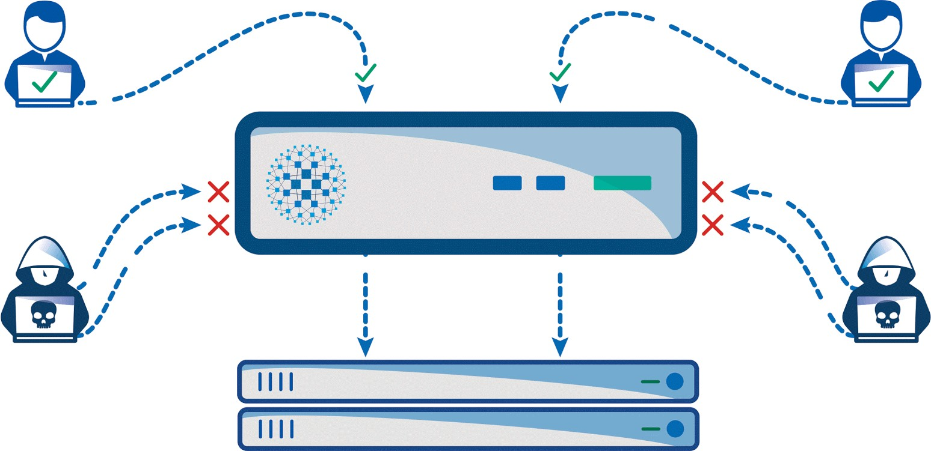
TCP Protocol and Attacks

Slide 23
TCP Protocol
TCP Overview
Transmission Control Protocol (TCP) is a core protocol of the Internet protocol suite.
Sits on the top of the IP layer; transport layer.
Provide host-to-host communication services for applications.
The Need for TCP
Providing a Virtual Connection
Maintaining Order
Reliability
Flow Control
Recall: Two transport Layer protocols
TCP: provides a reliable and ordered communication channel between applications.
UDP: lightweight protocol with lower overhead and can be used for applications that do not require reliability or communication order.
SEED lectures

Slide 24
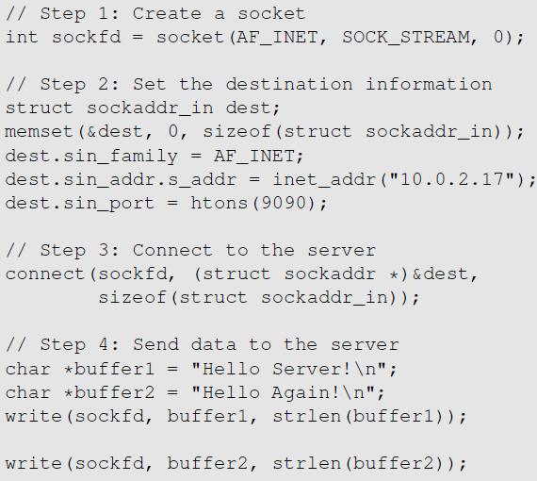
TCP Client Program
TCP overview
Create a socket; specify the type of communication. TCP uses SOCK_STREAM and UDP uses SOCK_DGRAM.
Initiate the TCP connection
Send data

Slide 25
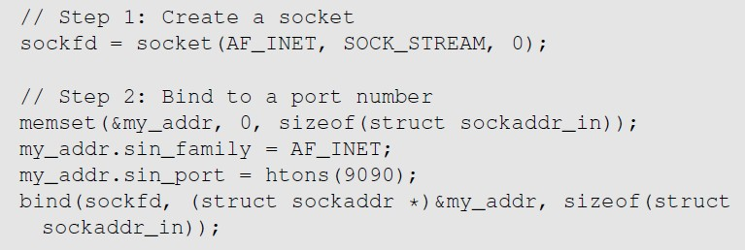
TCP Server Program (cont.)
TCP Overview
Step 1 : Create a socket. Same as Client Program.
Step 2 : Bind to a port number. An application that communicates with others over the network needs to register a port number on its host computer. When the packet arrives, the operating system knows which application is the receiver based on the port number. The server needs to tell the OS which port it is using. This is done via the bind() system call

Slide 26
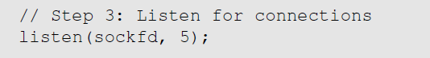
TCP Server Program (cont.)
TCP Overview
Step 3 : Listen for connections.
After the socket is set up, TCP programs call listen() to wait for connections.
It tells the system that it is ready to receive connection requests.
Once a connection request is received, the operating system will go through the 3-way handshake to establish the connection.
The established connection is placed in the queue, waiting for the application to take it.
The second argument (5) gives the number of connection that can be stored in the queue.

Slide 27
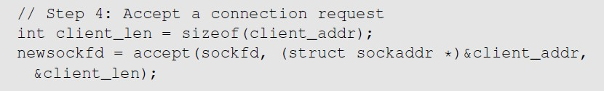
TCP Server Program (cont.)
TCP Overview
Step 4: Accept a connection request
After the connection is established, an application needs to “accept” the connection before being able to access it. The accept() system call extracts the first connection request from the queue, creates a new socket, and returns the file descriptor referring to the socket.
Step 5 : Send and Receive data
Once a connection is established and accepted, both sides can send and receive data using this new socket.

Slide 28
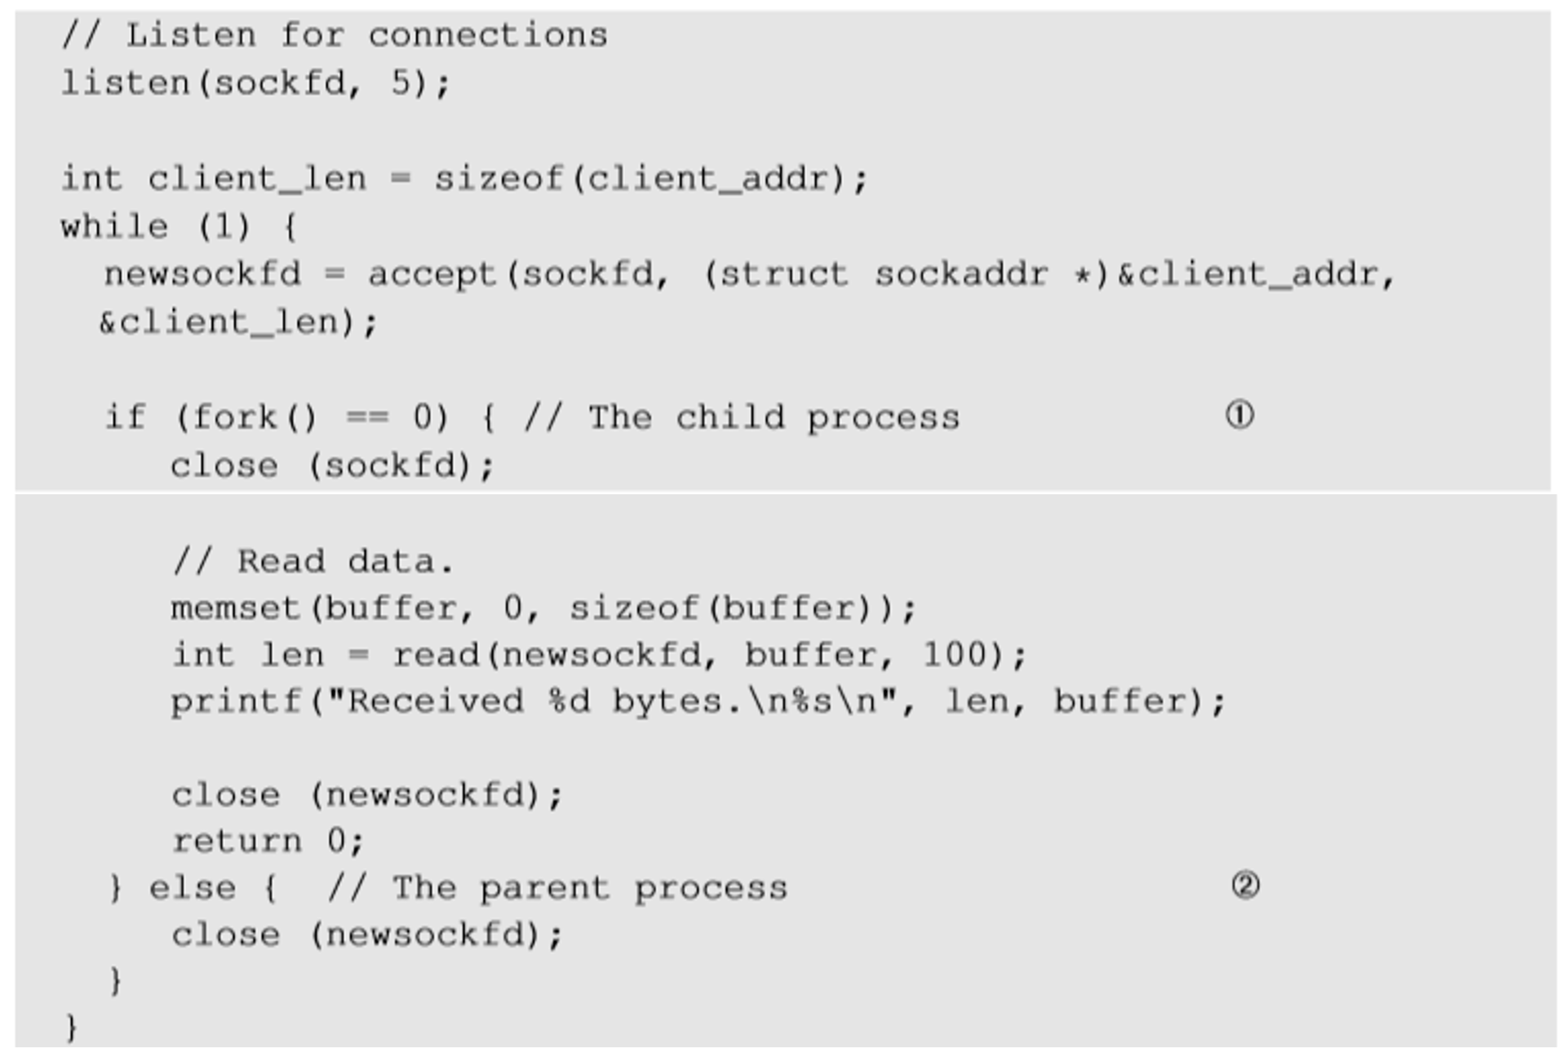
Improved TCP Server Program
TCP Overview
To accept multiple connections :
fork() system call creates a new process by duplicating the calling process.
On success, the process ID of the child process is returned in the parent process and 0 in the child process.
Line ! and Line " executes child and parent process respectively.

Slide 29
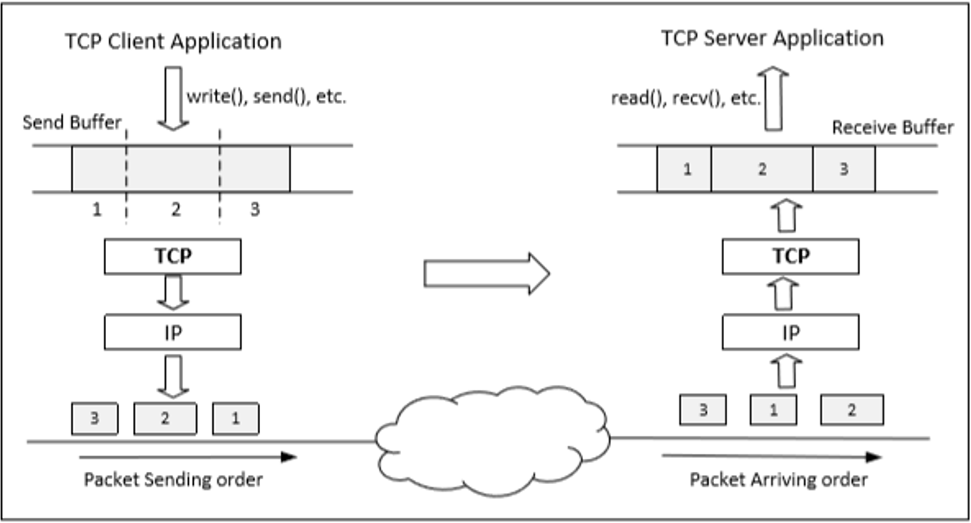
TCP Data Transmission (cont.)
Send/Receive buffers
Once a connection is established, OS allocates two buffers at each end, one for sending data (send buffer) and receiving buffer (receive buffer).
When an application needs to send data out, it places data into the TCP send buffer.

Slide 31
TCP Data Transmission (cont.)
Send/Receive buffers
Each octet in the send buffer has a sequence number field in the header which indicates the sequence of the packets. At the receiver end, these sequence numbers are used to place data in the right position inside receive buffer.
Once data is placed in the receive buffer, they are merged into a single data stream.
Applications read from the receive buffer. If no data is available, it typically gets blocked. It gets unblocked when there is enough data to read.
The receiver informs the sender about receiving of data using acknowledgement packets
Question: If two programs on the same machine send data to the same TCP server on another machine, would the server mix their data? What if the server is a UDP server?

Slide 32









Connection-oriented demultiplexing: example
application
application P1
transport
network
link
physical
P4
P5
P6
application
P2 P3
transport
network
transport
link
network
physical
link
server: IP address B
physical
host: IP address A
source IP,port: B,80 dest IP,port: A,9157
host: IP address C
source IP,port: C,5775 dest IP,port: B,80
source IP,port: A,9157 dest IP, port: B,80
source IP,port: C,9157 dest IP,port: B,80
Three segments, all destined to IP address: B,
dest port: 80 are demultiplexed to different sockets

Slide 33






Connectionless demultiplexing: an example
DatagramSocket serverSocket = new DatagramSocket
DatagramSocket mySocket2 = new DatagramSocket
DatagramSocket mySocket1 = new DatagramSocket (5775);
(6428);
(9157);
application
P1
application
P3
application
P4
transport
transport
network
transport
network
link
network
link
physical
link
physical
physical
source port: 6428
dest port: 9157
source port: ? dest port: ?
source port: 9157
dest port: 6428
source port: ? dest port: ?

Slide 34
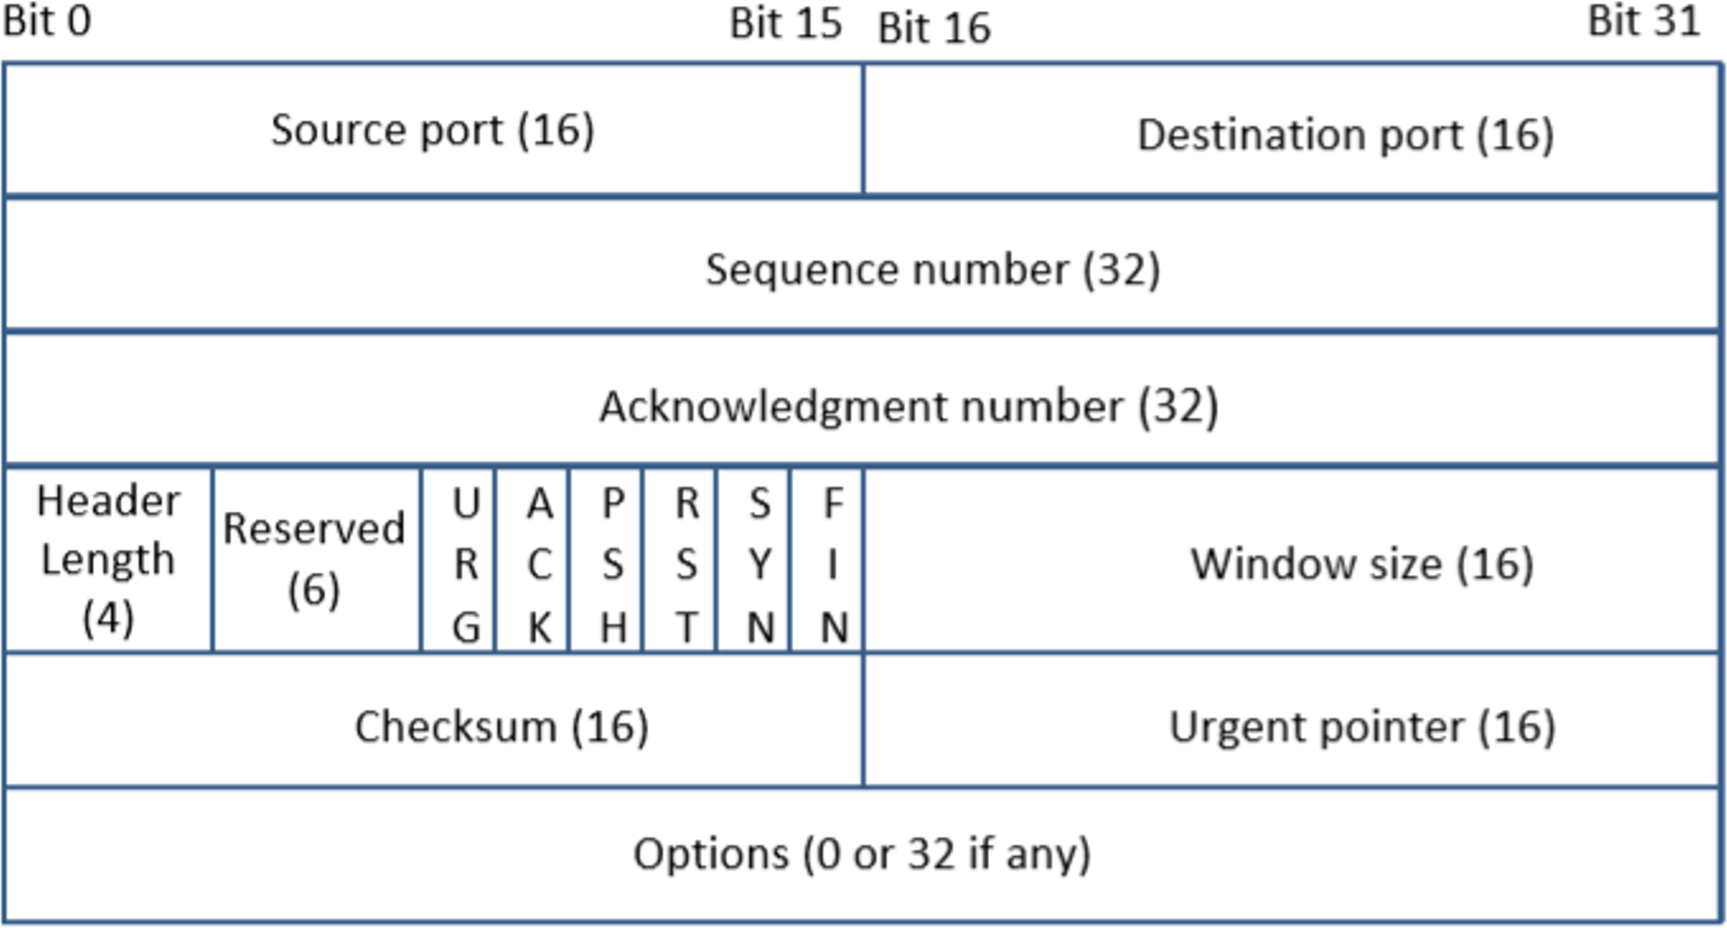
TCP Header
TCP overview
TCP Segment = TCP Header + Data.
Source and Destination port (16 bits each): Specify port numbers of the sender and the receiver.
Sequence number (32 bits) : Specifies the sequence number of the first octet in the TCP segment. If SYN bit is set, it is the initial sequence number.
Acknowledgement number (32 bits): Contains the value of the next sequence number expected by the sender of this segment. Valid only if ACK bit is set.

Slide 35
TCP Header
TCP overview
Header length (4 bits): Length of TCP header is measured by the number of 32-bit words in the header, so we multiply by 4 to get number of octets in the header.
Reserved (6 bits): This field is not used.
Code bits (6 bits): There are six code bits, including SYN,FIN,ACK,RST,PSH and URG.
Window (16 bits): Window advertisement to specify the number of octets that the sender of this TCP segment is willing to accept. The purpose of this field is for flow control.
Checksum (16 bits): The checksum is calculated using part of IP header, TCP header and TCP data.
Urgent Pointer (16 bits): If the URG code bit is set, the first part of the data contains urgent data (do not consume sequence numbers). The urgent pointer specifies where the urgent data ends and the normal TCP data starts. Urgent data is for priority purposes as they do not wait in line in the receive buffer, and will be delivered to the applications immediately.
Options (0-320 bits, divisible by 32): TCP segments can carry a variable length of options which provide a way to deal with the limitations of the original header.

Slide 36
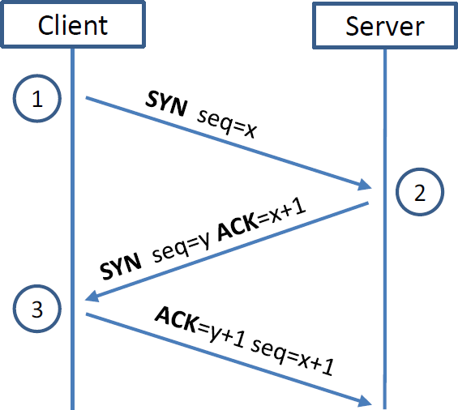
TCP 3-way Handshake Protocol
TCP overview
SYN Packet:
The client sends a special packet called SYN packet to the server using a randomly generated number x as its sequence number.
SYN-ACK Packet:
On receiving it, the server sends a reply packet
using its own randomly generated number y as its sequence number.
ACK Packet
Client sends out ACK packet to conclude the handshake
Notes:
SYN seq= x = (random number)
SYN seq = y = (random number)

Slide 37
TCP 3-way Handshake Protocol
TCP overview
When the server receives the initial SYN packet, it uses TCB (Transmission Control Block) to store the information about the connection.
This is called half-open connection as only client-server connection is confirmed.
The server stores the TCB in a queue that is only for the half-open connection.
After the server gets ACK packet, it will take this TCB out of the queue and store in a different place.
If ACK doesn’t arrive, the server will resend SYN+ACK packet. The TCB will eventually be discarded after a certain time period.

Slide 38
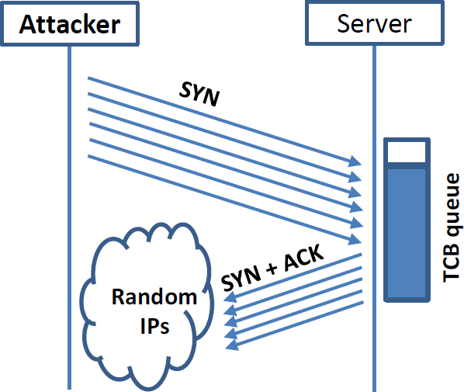
SYN Flooding Attack (cont.)
TCP Attacks
Idea: To fill the queue storing the half-open connections so that there will be no space to store TCB for any new half-open connection, basically the server cannot accept any new SYN packets.
Steps to achieve this: Continuously send a lot of SYN packets to the server. This consumes the space in the queue by inserting the TCB record.
Do not finish the 3rd step of handshake as it will dequeue the TCB record.

Slide 39
SYN Flooding Attack
TCP Attacks
When flooding the server with SYN packets, we need to use random source IP addresses; otherwise the attacks may be blocked by the firewalls.
The SYN+ACK packets sent by the server may be dropped because forged IP address may not be assigned to any machine.
If it does reach an existing machine, a RST packet will be sent out, and the TCB will be dequeued.
As the second option is less likely to happen, TCB records will mostly stay in the queue. This causes SYN Flooding Attack.

Slide 40
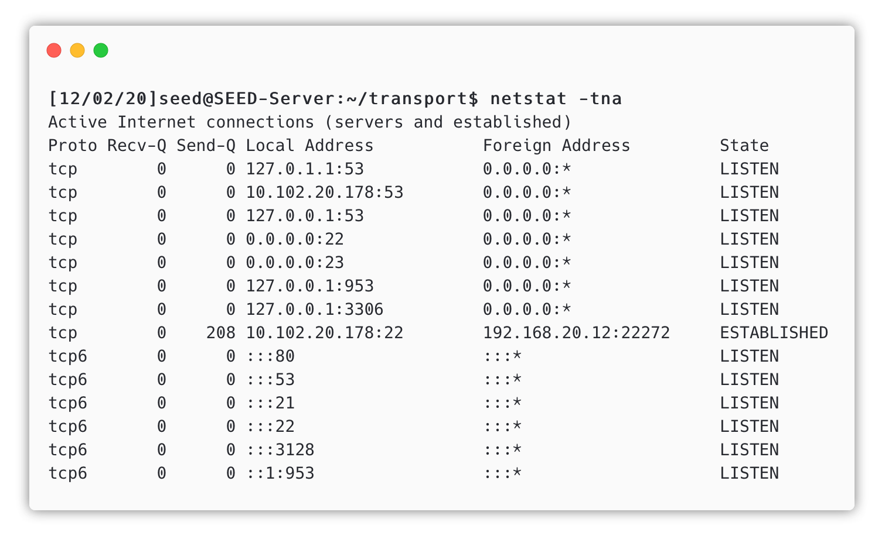
Launching SYN Flooding Attack: Before Attacking
TCP Attacks
Check the TCP states
TCP States
LISTEN: waiting for TCP connection.
ESTABLISHED: completed 3-way handshake
SYN_RECV: half-open connections

Slide 41
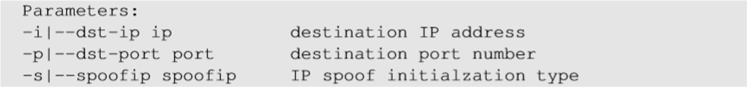
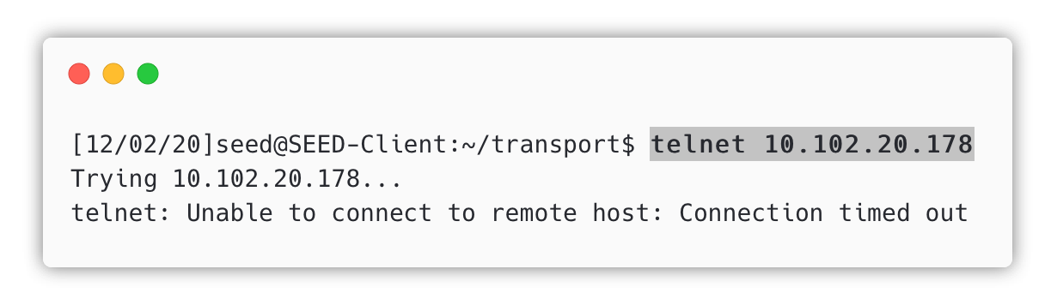
SYN Flooding Attack – Launch the Attack
Using netwox tool
Turn off the SYN Cookie countermeasure:
$sudo sysctl -w net.ipv4.tcp_syncookies=0
Launch the attack using netwox
$ sudo netwox 76 -i 10.102.20.178 -p 23 -s raw
Targeting telnet server
Result

Slide 43
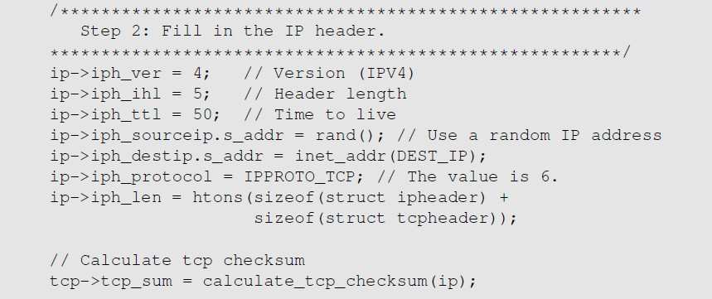
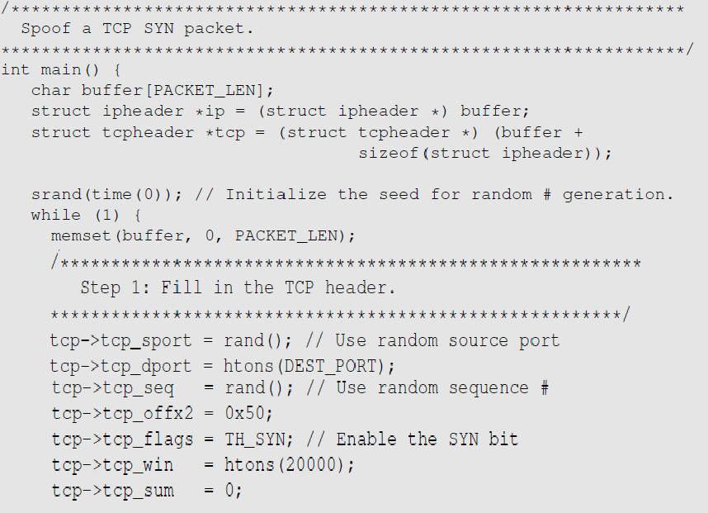
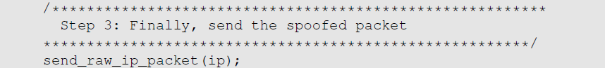
SYN Flooding Attack - Launch with Spoofing Code
Using C
We can write our own code to spoof IP SYN packets.

Slide 44
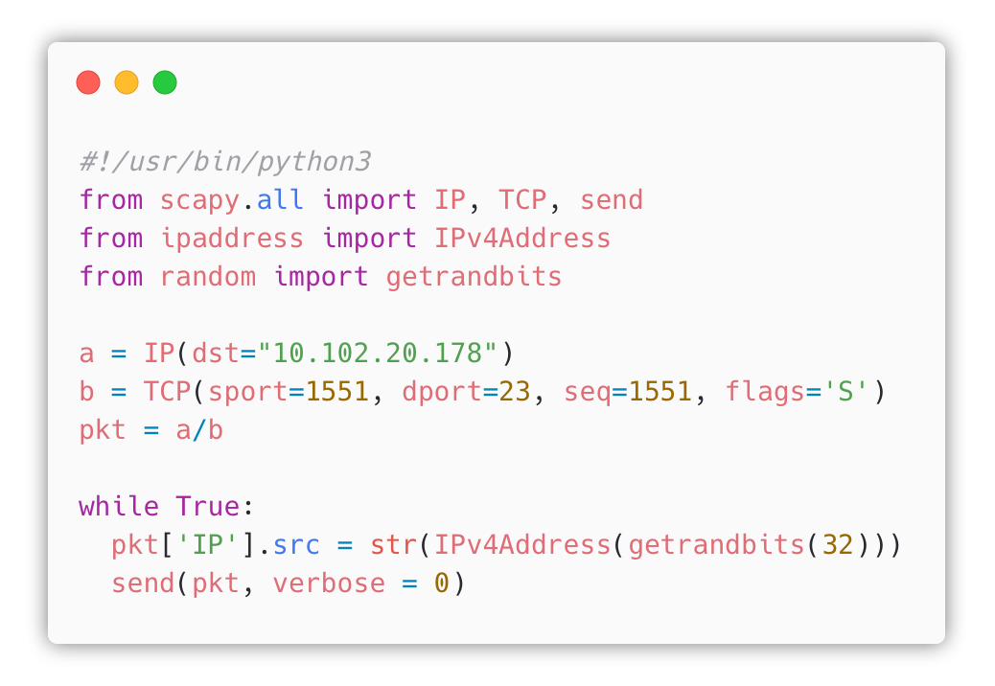
SYN Flooding Attack - Launch with Spoofing Code
Using Scapy

Slide 45
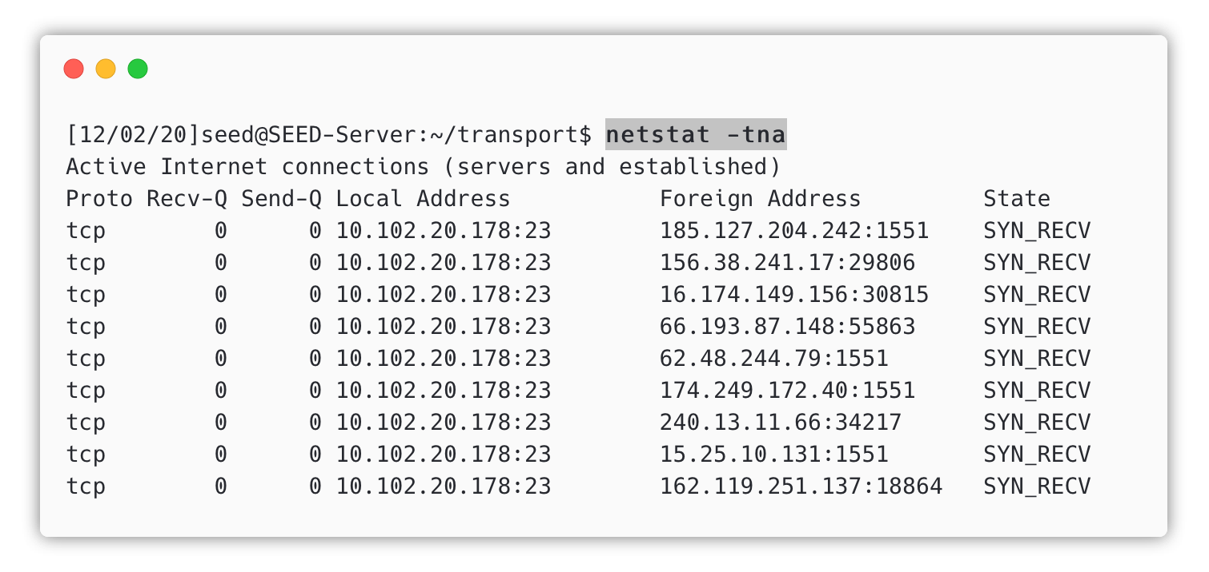
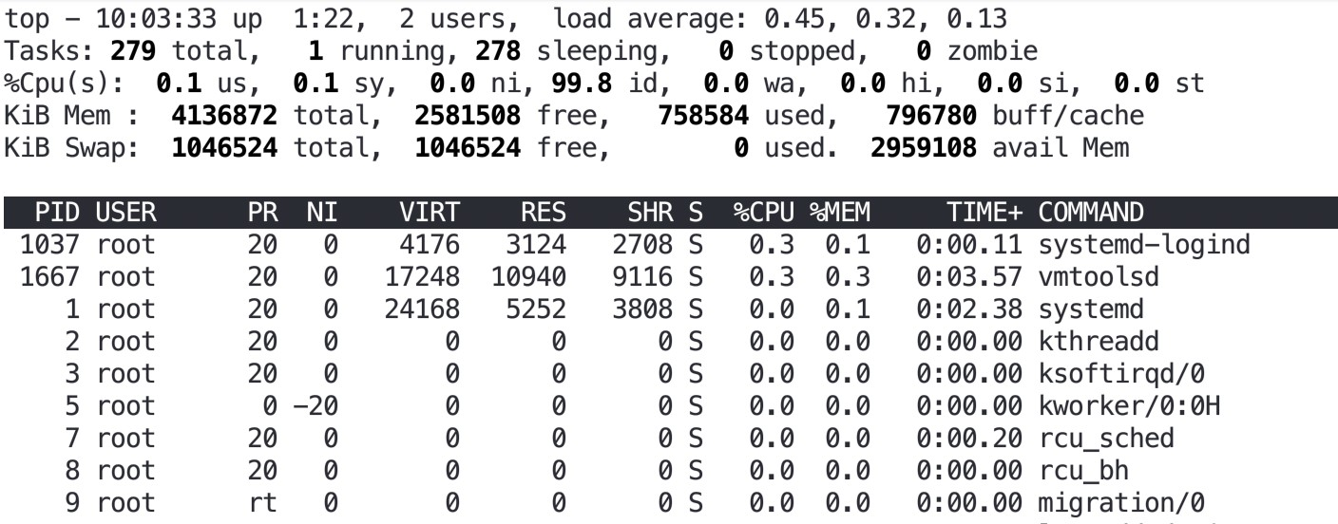
SYN Flooding Attack
Results
Using netstat command, we can see that there are a large number of half-open connections on port 23 with random source IPs.
Using top command, we can see that CPU usage is not high on the server machine. The server is alive and can perform other functions normally, but cannot accept telnet connections only.

Slide 46

SYN Cookies
Countermeasures
If it is getting filled up quickly the think cookie will kick in now when the thin cookie kick in
After a server receives a SYN packet, it calculates a keyed hash (H) from the information in the packet using a secret key that is only known to the server.
This hash (H) is sent to the client as the initial sequence number from the server. H is called SYN cookie.
The server will not store the half-open connection in its queue.
If the client is an attacker, H will not reach the attacker.
If the client is not an attacker, it sends H+1 in the acknowledgement field.
The server checks if the number in the acknowledgement field is valid or not by recalculating the cookie.
🏡 Homework: Find out how SYN cookies work in detail
https://en.wikipedia.org/wiki/SYN_cookies

Slide 47
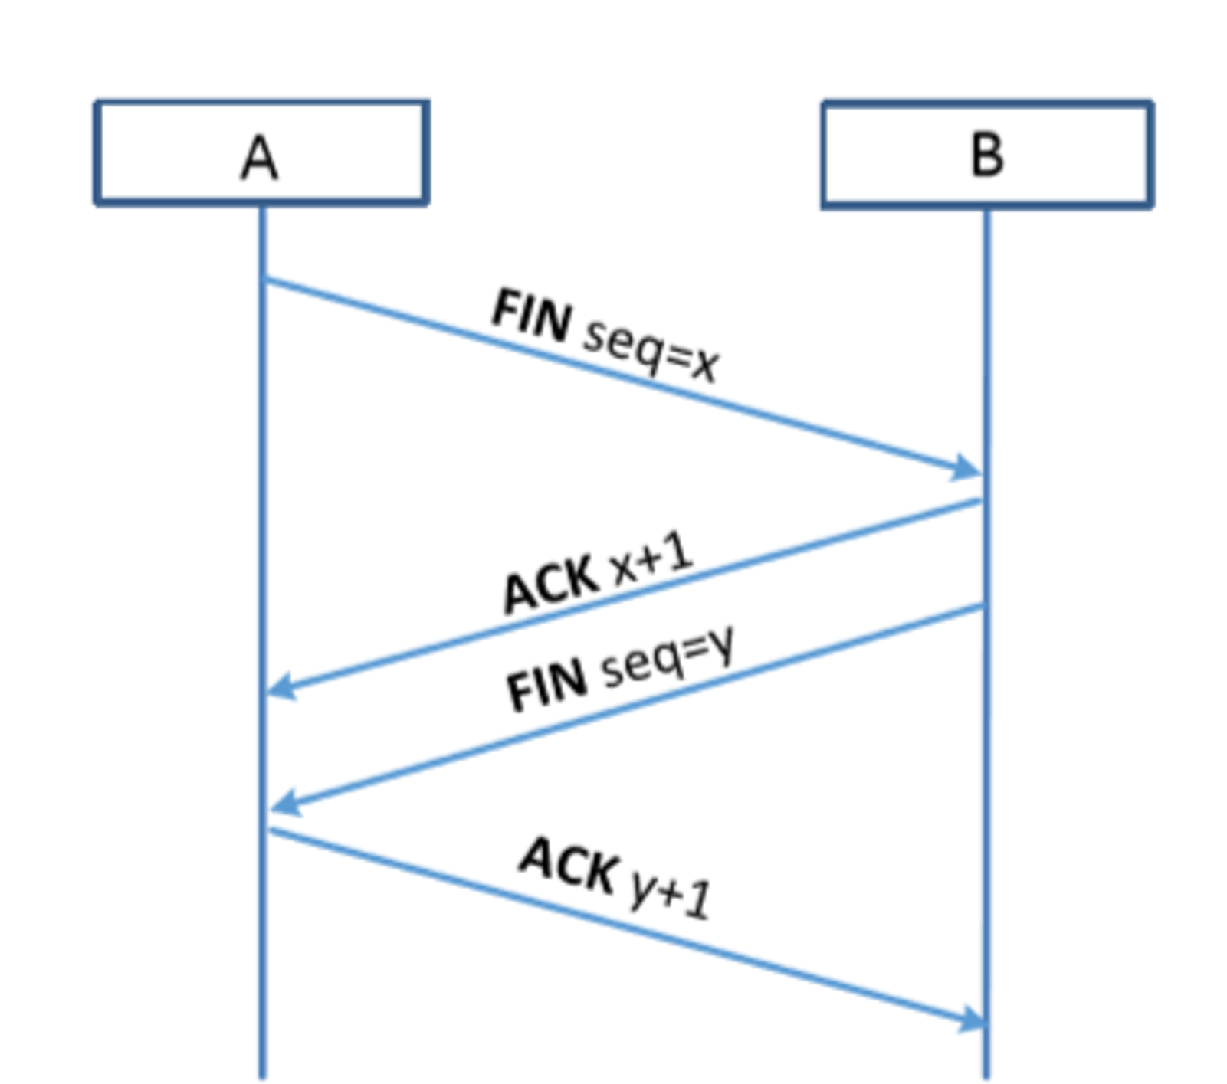
TCP Reset Attack
How to close TCP connections?
To disconnect a TCP connection :
A sends out a “FIN” packet to B.
B replies with an “ACK” packet. This closes the A- to-B communication.
Now, B sends a “FIN” packet to A and A replies with “ACK”.
Using Reset flag :
One of the parties sends RST packet to immediately break the connection.
Don’t need to wait ACK

Slide 48
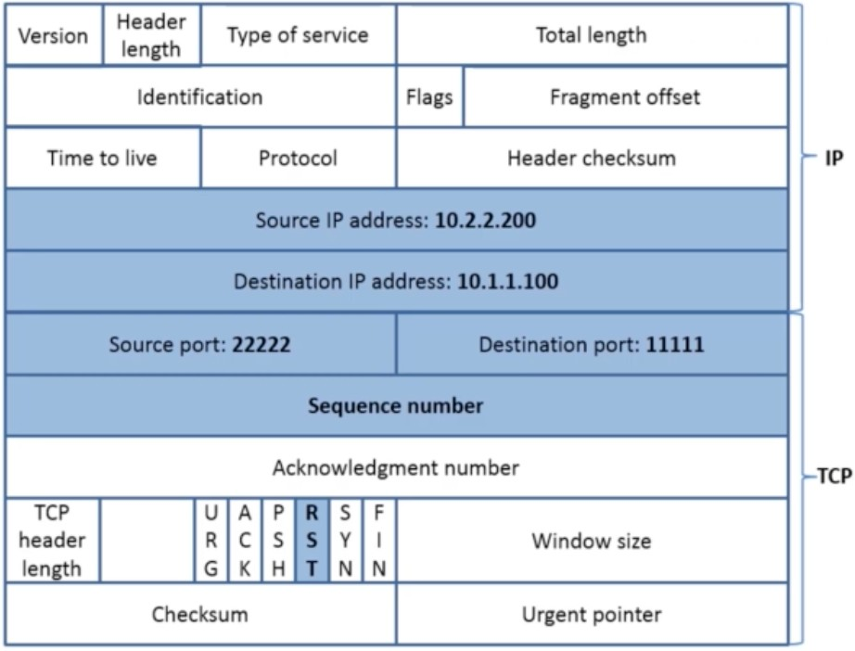
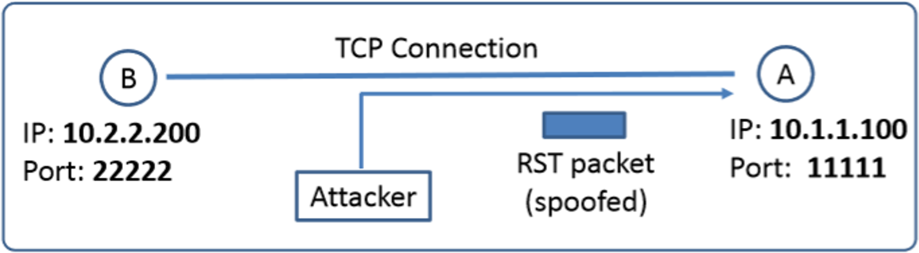
TCP Reset Attack
TCP Attacks
Goal: To break up a TCP connection between A and B.
Spoofed RST Packet: The following fields need to be set correctly:
Source IP address, Source Port,
Destination IP address, Destination Port
Sequence number (within the receiver’s window)

Slide 49
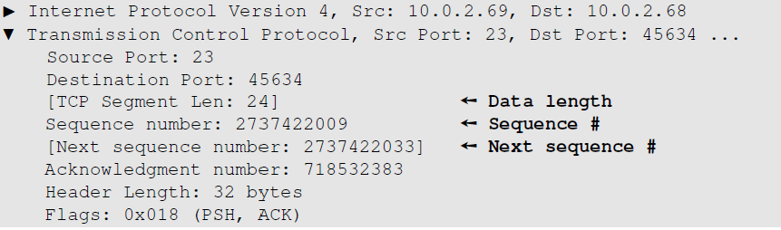
Captured TCP Connection Data
How to get the Sequence number?
Steps :
Use Wireshark on attacker machine, to sniff the traffic.
Retrieve the destination port (23), Source port number and sequence number.
How to get the seq# automatically?

Slide 50


TCP Reset Attack on Telnet Connection
TCP Attacks

Slide 52

TCP Reset Attack on SSH connections
TCP Attacks
If the encryption is done at the network layer, the entire TCP packet including the header is encrypted, which makes sniffing or spoofing impossible.
But as SSH conducts encryption at Transport layer, the TCP header remains unencrypted. Hence the attack is successful as only header is required for RST packet.

Slide 53

TCP Reset Attack on Video-Streaming Connections
TCP Attacks
This attack is similar to previous attacks only with the difference in the sequence numbers as in this case, the sequence numbers increase very fast unlike in Telnet attack as we are not typing anything in the terminal.
To achieve this, we use Netwox 78 tool to reset each packet that comes from the user machine (10.0.2.18). If the user is watching a Youtube video, any request from the user machine will be responded with a RST packet.

Slide 54

TCP Reset Attack on Video-Streaming Connections
TCP Attacks
Note: If RST packets are sent continuously to a server, the behavior is suspicious and may trigger some punitive actions taken against the user.

Slide 55

TCP Session Hijacking Attack
TCP Attacks
Goal: To inject data in an established connection.
Spoofed TCP Packet: The following fields need to be set correctly:
Source IP address, Source Port,
Destination IP address, Destination Port
Sequence number (within the receiver’s window)

Slide 56

TCP Session Hijacking Attack: Sequence Number
TCP Attacks
If the receiver has already received some data up to the sequence number x, the next sequence number is x+1. If the spoofed packet uses sequence number as x+𝛿, it becomes out of order.
The data in this packet will be stored in the receiver’s buffer at position x+𝛿, leaving 𝛿
spaces (having no effect). If 𝛿 is large, it may fall out of the boundary.

Slide 57


Hijacking a Telnet Connection
TCP Attacks
With Next Sequence Number
Without Next Sequence Number
Steps:
User establishes a telnet connection with the server.
Use Wireshark on attacker machine to sniff the traffic
Retrieve the destination port (23), source port number (46712) and sequence number.

Slide 58

What Command Do We Want to Run
TCP Attacks
By hijacking a Telnet connection, we can run an arbitrary command on the server, but
what command do we want to run?
Consider there is a top-secret file in the user’s account on Server called “secret”. If the attacker uses “cat” command, the results will be displayed on server’s machine, not on the attacker’s machine.
In order to get the secret, we run a TCP server program so that we can send the secret from the server machine to attacker’s machine.

Slide 59

Session Hijacking: Steal a Secret
TCP Attacks
“cat” command prints out the content of the secret file, but instead of printing it out locally, it redirects the output to a file called /dev/tcp/10.0.2.16/9090 (virtual file in /dev folder which contains device files). This invokes a pseudo device which creates a connection with the TCP server listening on port 9090 of 10.0.2.16 and sends data via the connection.
The listening server on the attacker machine will get the content of the file.

Slide 60



Launch the TCP Session Hijacking Attack
TCP Attacks
Attacker
Client
→ Freeze

Slide 61

What Happens to The Session?
TCP Attacks
Once the attack is successful, telnet connection freezes. It can no longer be used. What happened?
→ Both user and server have entered the deadlock

Slide 62
Creating Reverse shell
TCP Attacks
The best command to run after having hijacked the connection is to run a reverse shell command.
To run shell program such as /bin/bash on Server and use input/output devices that can be controlled by the attackers.
The shell program uses one end of the TCP connection for its input/output and the other end of the connection is controlled by the attacker machine.
Reverse shell is a shell process running on a remote machine connecting back to the attacker.
It is a very common technique used in hacking.

Slide 63


File Descriptors and Standard IO
File descriptor table
File descriptor 0 represents the standard input device (stdin)
File descriptor 1 represents the standard output device (stdout)
File descriptor 2 represents the standard error (stderr).
> write permission
< read permission
& redirect

Slide 64
Reverse Shell
TCP Reverse Shell
File descriptor 0 represents the standard input device (stdin) and 1 represents the standard output device (stdout). Since the stdout is already redirected to the TCP connection, this option basically indicates that the shell program will get its input from the same TCP connection.
The option i stands for interactive, meaning that the shell should be interactive.
This causes the output device (stdout) of the shell to be redirected to the TCP connection to 10.0.2.70’s port 9090.
File descriptor 2 represents the standard error (stderr). This cases the error output to be redirected to stdout, which is the TCP connection.

Slide 65



TCP Hijacking with Reverse Shell
Demo
Client (telnet to Server – 178)
Attacker machine
Successful!

Slide 66
Defending Against Session Hijacking
Countermeasures
Making it difficult for attackers to spoof packets
Randomize source port number (16 bits)
Randomize initial sequence number (32 bits)
→ Guest a random 48-bit number !!!
* Not effective against local attacks
Encrypting payload
Attackers need to know how the data is encrypted ➔ the encryption key
➔ Encryption is one of the fundamental solutions to many of the attacks on the Internet.

Slide 67
Summary
What have we learned?
Transport layer
UDP Protocol
UDP Attacks
UDP Ping pong attacks
UDP Flooding – DoS attacks
TCP protocol
Three-way handshake protocol
TCP Attacks
SYN flooding attack
TCP reset attack
TCP session hijacking attack
The Mitnick attack
Reverse shell
Countermeasures

Slide 68


Homework (Bonus points )
Lab exercise
Lab 1: TCP Attack Lab (Link)
The learning objective of this lab is for students to gain first-hand experience on three types of attacks on TCP, including the SYN flooding attack, TCP reset attack, and TCP session hijacking attack.
Lab 2: The Mitnick Attack Lab (Link)
(optional with .ATCL class, mandatory with .ANTN class)
The objective of this lab is to recreate the classic Mitnick attack, so students can gain the first-hand experience on such an attack. We will emulate the settings that was originally on Shimomura's computers, and then launch the Mitnick attack to create a forged TCP session between two of Shimomura's computers. If the attack is successful, we should be able to run any command on Shimomura's computer.

Slide 69



For next time…
Looking ahead
Ready for next class:
Tentative topic: Application layer, DNS and Attacks
Reading and practicing (in advance):
SEED book, Chapter 18
Refs: https://www.handsonsecurity.net/resources.html
SEED Lab: Local DNS Attack Lab, Remote DNS Attack Lab and DNS Rebinding Attack Lab
Refs:
https://seedsecuritylabs.org/Labs_16.04/Networking/DNS_Local/
https://seedsecuritylabs.org/Labs_16.04/Networking/DNS_Remote/
https://seedsecuritylabs.org/Labs_16.04/Networking/DNS_Rebinding/

Slide 70

Today end,
Congrats!

